Slide 1
Data Mining Modeling Tips and Mistakes

Slide 2
Agenda
Characteristics of Different Modeling Algorithms – use terminology from “Data Mining” by Weiss and Davison reading assignment from The Handbook of Technology Management
Expressive Capabilities
Model Comprehensibility
Model Explainability
Top 10 Data Mining Mistakes from Handbook of Statistical Analysis and Data Mining Applications by Nisbet, Elder, Miner

Slide 3
Expressive Capabilities
An algorithm’s expressive capability refers to the complexity of decision boundaries it can form
Examples of 2-Dimensional decision boundaries:
Linear regression is a straight line
Decision tree is a combination of straight lines (non-linear)
Neural Network is a curvilinear line (non-linear)
Clustering analysis is a group of regions around a point

Slide 4
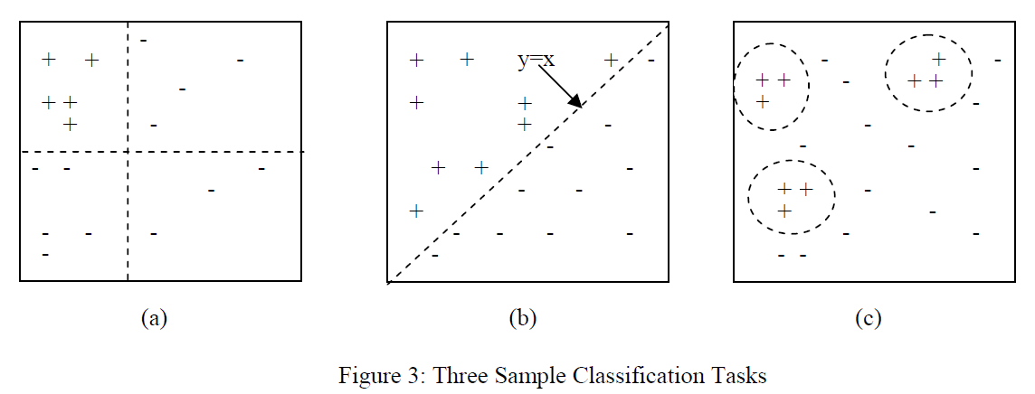
Examples of Model Boundaries
Decision Tree Linear Regression Clustering
Source: “Data Mining” by Weiss and Davison from The Handbook of Technology Management

Slide 5
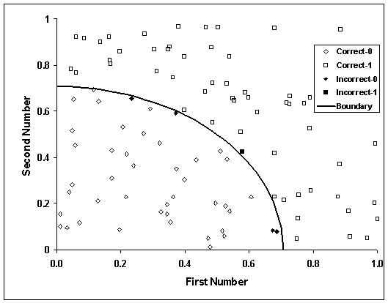
Example of a Non-linear Neural Network Boundary
Source: http://www.argentumsolutions.com/tutorials/neural_tutorialpg6.html

Slide 6
Table of Some Supervised Modeling Node Properties
Model | Target Types | Predictor Types | Expressive Quality | Comprehensibility | Explainability | Missing Predictor Value Handling
Linear Regression | Continuous | Both | Low | Medium | Medium | Impute
Logistic Regression | Discrete | Both | Medium | Medium | Medium | Impute
CHAID Decision Tree | Both | Both - Bin Continuous | High | High – Generates Rules | High – Detailed Rules | Separate Category
CRT Decision Tree | Both | Both | High | High – Generates Rules | High – Detailed Rules | Use Surrogate
C5.0 Decision Tree | Discrete | Both | High | High – Generates Rules | High – Detailed Rules | Use Fractionalization
QUEST Decision Tree | Discrete | Both | High | High – Generates Rules | High – Detailed Rules | Use Surrogate
Neural Network | Both | Both | Very High – Flexible, Non-linear | Low | Low | Impute
Support Vector Machine | Both | Both | Very High – Flexible, Non-linear | Low | Low | Impute
Bayesian Belief Net | Discrete | Both – Bin Continuous | High | Medium | High | Impute

Slide 7
Top 10 Data Mining Mistakes From Handbook of Statistical Analysis and Data Mining Applications by Nisbet, Elder, Miner
0. Lack Data
1. Focus on Training
2. Rely on One Technique
3. Ask the Wrong Question
4. Listen (only) to the Data
5. Accept Leaks from the Future
6. Discount Pesky Cases
7. Extrapolate
8. Answer Every Inquiry
9. Sample Casually
10. Believe the Best Model

